Slide 1
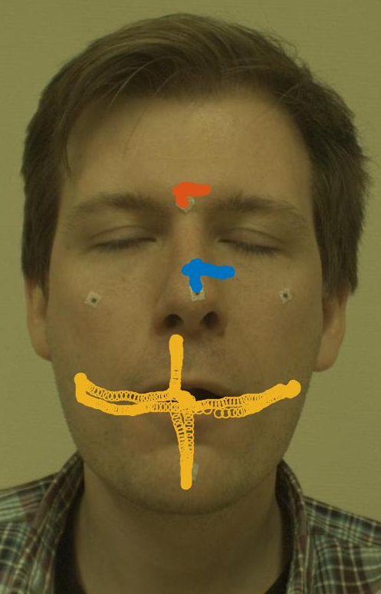
Project 4 – 3d Tracking of facial features
Image Processing and computer Vision
Tracking an individual tongue for determining range of motion

Slide 2
Methodology
Camera calibration
Selecting Regions of Interest (ROI)
Tracking Regions of Interest in 2D
Triangulating the ROIs in 3D space
Range of motion estimation from fixed coordinate system on subject’s face.

Slide 3
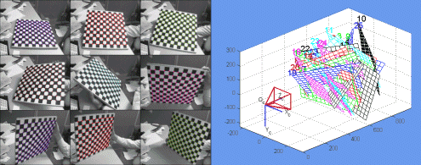
Camera calibration
The cameras were calibrated using the Camera Calibration toolbox for MATLAB.
This gives us camera extrinsics and intrinsics like camera focal length, skew coefficient, distortions, rotations and translations.
A standardized checkerboard pattern is used to estimate the camera properties.

Slide 4
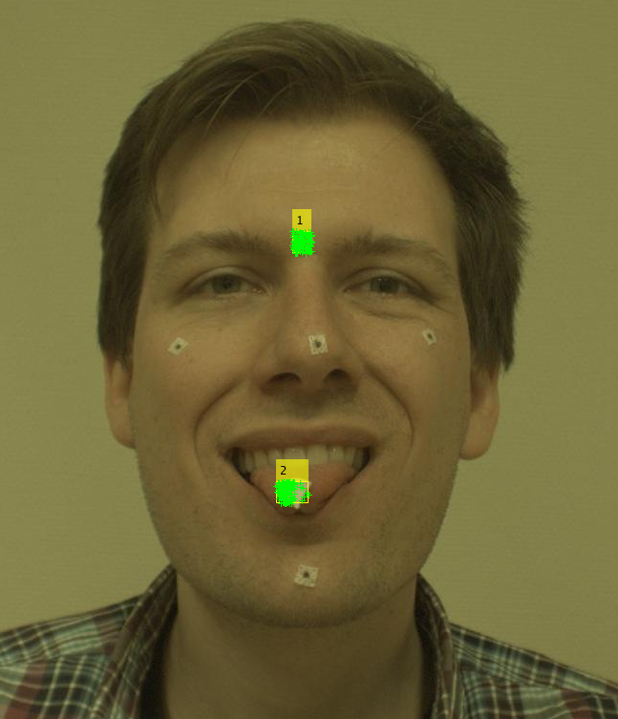
2D Tracking – Regions of Interest
For tracking in 2D, a static reference region and the tracking region is manually selected.
Then points are generated in the ROI using the Eigen Features algorithm.

Slide 5
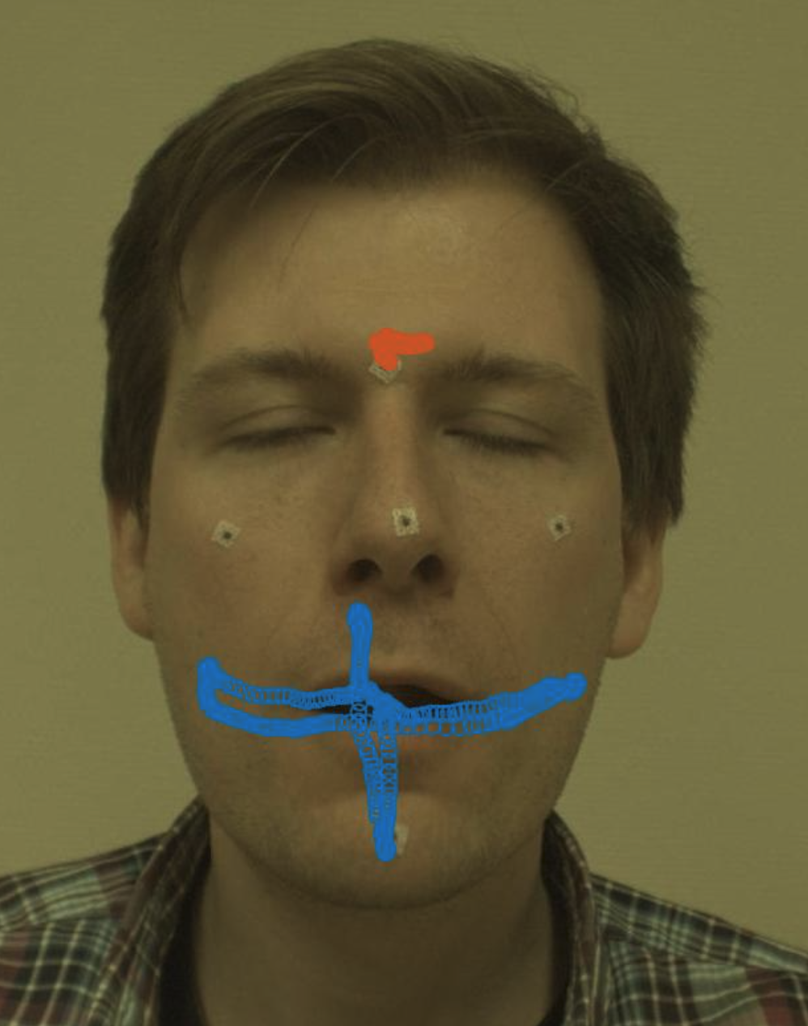
2D Tracking – Tracking points
Using the Kanade-Lucas-Tomasi (KLT) feature tracking algorithm, we track the set of points generated from the ROI bounding boxes.
When the tongue disappears, the video is paused and skipped forward to reselect the ROI for the tongue.
RANSAC is used to reject outliers to any of the path data generated by the tracking algorithm.
Notes:
The skipping of frames is manual.

Slide 6
Triangulating the ROIs in 3D space
The cameras were calibrated using the Camera Calibration toolbox for MATLAB.

